Slide 1

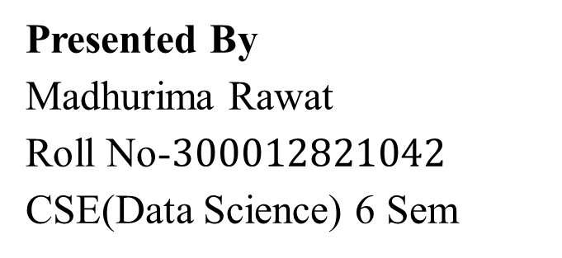
Pre-failure Alerting in BRM
Faculty Mentor: Mr. Abhinaw Jagtap
Guide: Dr. Gagan Raj Gupta
Associate Professor, IIT Bhilai
Presented By Madhurima Rawat Roll No-$300012821042$ CSE(Data Science) 6 Sem
Notes:
Welcome to my presentation. I am currently interning at IIT Bhilai, where I am actively involved in a project. This presentation outlines the project itself, along with my contributions to it. Additionally, I will discuss the resources utilized and the skills acquired throughout this internship.

Slide 2

Contents
Introduction
Background
Objectives
Methodology
Results
Discussion
Conclusion
Acknowledgments
References
Notes:
To facilitate seamless navigation, hyperlinks have been incorporated into each section. Simply click on the point to be directed to the corresponding section.

Slide 3
Introduction
Project Introduction and Significance of the Topic
Notes:
Introducing the project 'Pre-failure Alerting in BRM,' highlighting its pivotal role in proactive risk mitigation.

Slide 4
Introduction
Manual data entry leads to inefficiencies and errors, prompting the need for automated solutions in managing BRM (Bar and Rod Mill) signals at BSP (Bhilai Steel Plant).
Lack of standardization in reporting formats poses challenges for data analysis and decision-making in the context of BRM signals at BSP.
Limited accessibility with physical document storage inhibits collaboration and timely access to information related to BRM signals.
Poor data analysis tools hinder insights into cobble-related activities specifically within the BRM operations at BSP.
Inefficient communication without a centralized platform underscores the necessity for streamlined communication channels within the BRM signal management system at BSP.
Notes:
Manual data entry inefficiencies prompt automated BRM signal management, while format inconsistencies, storage limitations, and communication inefficiencies hinder BSP operations.

Slide 5
Background
Background of the Project
Notes:
Presenting the background of the project 'Pre-failure Alerting in BRM,' highlighting its pivotal role in proactive risk mitigation through a comparison with traditional methods.

Slide 6
Problem-Solution Analysis
Issues with Manual Cobble logging
Solution: Streamlined User friendly Logging Platform
1. Manual data entry- Traditional methods involve manual data entry, leading to inefficiencies and errors.
2. Lack of standardization- Inconsistent reporting formats hinder data analysis and decision-making.
3. Limited accessibility- Physical document storage limits accessibility and collaboration.
4. Poor data analysis - Limited tools for analyzing cobble-related data.
5. Inefficient communication - Lack of a centralized communication platform.
The Cobble Reporting Website automates data entry with intuitive forms, reducing errors and accelerating the reporting process.
The website enforces standardized reporting formats, ensuring consistency and facilitating seamless data aggregation for enhanced insights.
Provides centralized, cloud-based storage, ensuring authorized users can access information anytime, anywhere
The website offers advanced data analysis tools, including graphical representations, for in-depth insights into cobble-related activities.
Centralized dashboard for efficient communication, real-time updates, and notifications to keep all stakeholders informed.
Implementation of robust data security measures, including encryption and access controls.
Admin panel; login logout details, filter logs created by users.
Real time data visualization and analytics.
Notes:
Here, I have added a comparison of the problem in the current manual system and the solutions given in this project.

Slide 7
Objectives
Main Aim of the Project
Notes:
By enhancing pre-failure alerting in BRM, aim is to optimize risk management

Slide 8
Objectives
Decode data: Extract meaningful insights from data to accurately identify motifs and discord patterns.
Analyze data for motifs and discord: Identify normal and anomalous patterns to minimize false positives in anomaly detection.
Use InfluxDB for storage: Utilize InfluxDB for efficient storage and retrieval of motifs and discordance patterns.
Apply threshold filtering: Implement threshold-based filtering to enhance motif identification and remove similar motifs(they just used up space and we need only one motif for that).
Visualize motifs in Grafana: Present top motifs in Grafana for actionable insights and informed decision-making.
Notes:
Here, the first objective is always decoding the data. Then data cleaning is done to remove ghost rolling intervals(where the mill is not working) and other drop in sensors. Motifs and discords are found later. After this the next part is about integrating this motifs in Grafana, for which influxdb is used as database.

Slide 9
Methodology
Outlining the Approach or Procedures used in Project
Notes:
Here, in this section I have described the methodology that I have used in this project during my internship. I have also added skills that I learned.

Slide 10
Methodology
IBA Analyzer(Data Decoding)
Stumpy
Data Visualization
InfluxDB
Grafana
Illustration 1: Resources Used
Notes:
The resources used are diverse tools and platforms for thorough data analysis. IBA is employed for data decoding, while Stumpy is utilized for motif-discord analysis. Data visualization is executed to illustrate these motifs-discords effectively. InfluxDB serves as the database to store the data, and Grafana is utilized for the visualization of the analyzed data.

Slide 11
Methodology Continued
Data Decoding:
The initial step involves decoding the raw data to extract meaningful insights necessary for identifying motifs and discordance patterns accurately.
The IBA Analyzer tool was utilized for this purpose. The original data is in .dat (Data file ) format.
Motif and Discord Analysis:
Stumpy, a Python library, along with Jupyter Notebook, was employed for analyzing the data to identify both normal motifs and anomalous discordance patterns.
This step aimed to distinguish between regular occurrences and anomalies to minimize false positives in anomaly detection.
Notes:
Here, the first objective is always decoding the data. Then data cleaning is done to remove ghost rolling intervals(where the mill is not working) and other drop in sensors. Motifs and discords are found later. After this the next part is about integrating this motifs in Grafana, for which influxdb is used as database.

Slide 12
Methodology Continued
Data Storage:
InfluxDB, a time-series database, was chosen as the platform for efficient storage and retrieval of motifs and discordance patterns.
The Python client library facilitated seamless integration with the database, ensuring optimal management of the data.
Threshold Filtering:
Threshold-based filtering techniques were implemented using Stumpy and Python.
Experimental knowledge and documentation resources were referenced to determine suitable threshold values and refine motif identification, thereby eliminating similar motifs and enhancing the accuracy of anomaly detection.
Notes:
For data storage, InfluxDB is employed due to its specialization as a time-series database, tailored specifically for handling time-centric data. Threshold filtering is applied to discern patterns amidst repeated motifs within signals, facilitating the analysis of diverse motifs.

Slide 13
Methodology Continued
Visualization:
The top motifs identified through the analysis were visualized using Grafana, leveraging its capabilities and the Flux query language.
This visualization step aimed to present actionable insights and facilitate informed decision-making based on the detected patterns.
By following this methodology, the data was decoded, motifs and discordance patterns were analyzed, relevant information was stored in InfluxDB, threshold filtering was applied, and the results were visualized in Grafana. This process ultimately improved the accuracy of anomaly detection and minimized false positives.
Notes:
Grafana is used for visualization adhering to its advance facilities regarding visualization like integration with influxdb and also the availability of panels.

Slide 14
Results
Presenting the Findings or Outcomes Obtained
Notes:
In this section, I have added the dashboard outputs from Grafana.

Slide 15
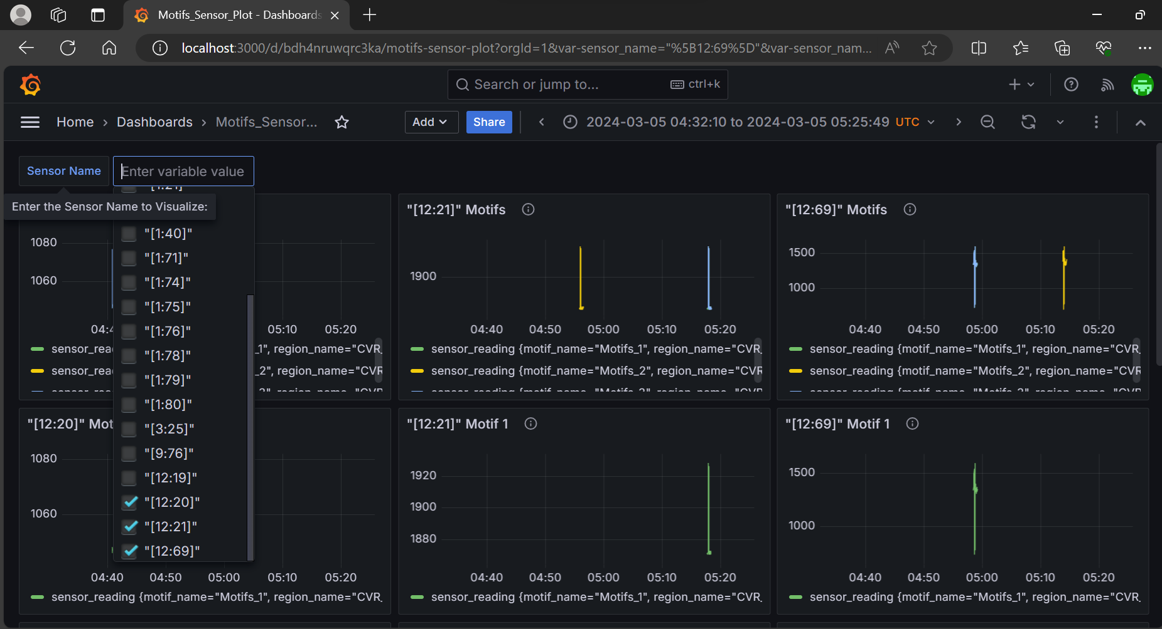
Result
Fig 1: Grafana Dashboard Showing the Selection Panel for Sensors
Notes:
From this dropdown, we can add the sensors.

Slide 16
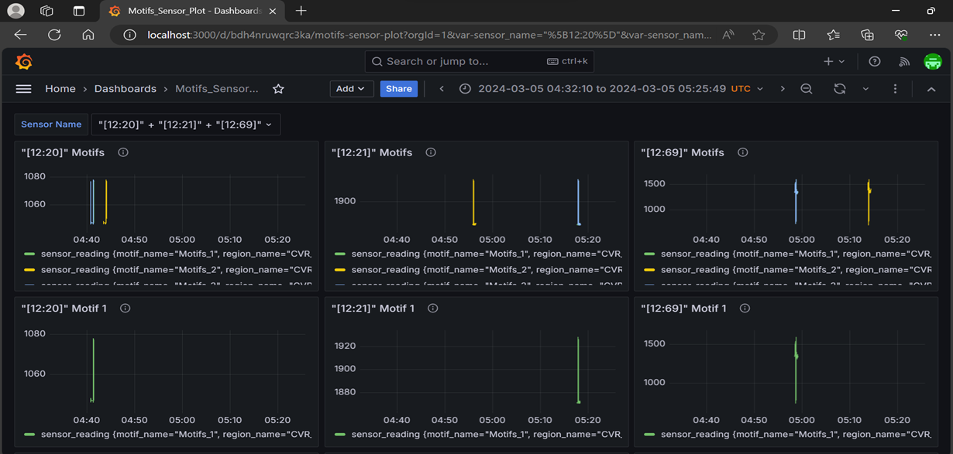
Result Continued
Fig 2: Grafana Dashboard Showing the Plot after Selection
Notes:
After sensor selection, the final graph generated displays all motifs detected from the chosen sensors, presented both individually and in distinct panels for enhanced clarity and analysis

Slide 17
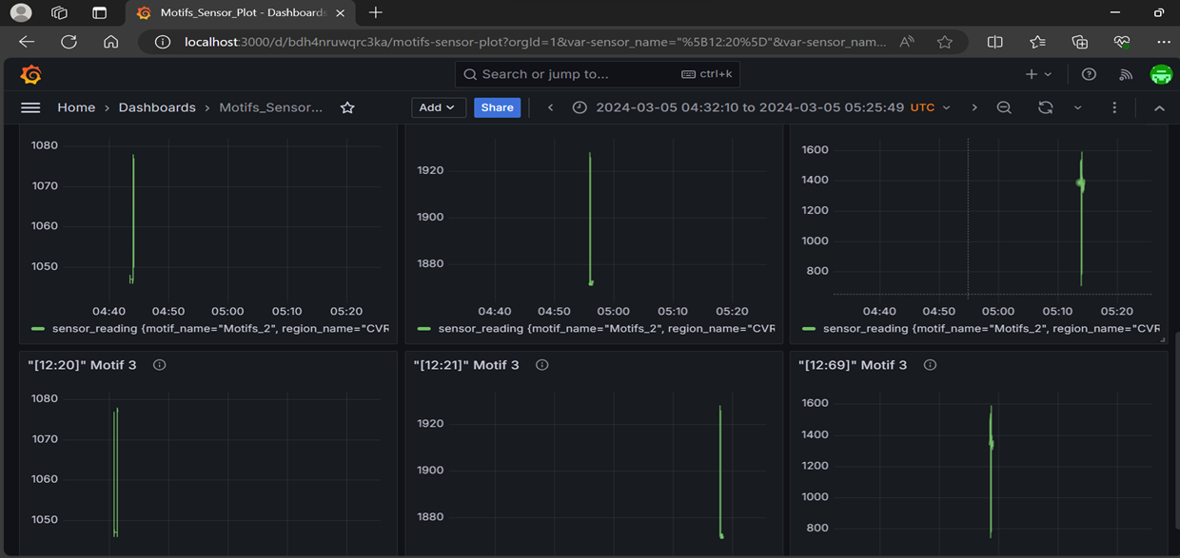
Result Continued
Fig 3: Grafana Dashboard Showing the Separate Motifs after Selection
Notes:
After sensor selection, the final graph generated displays all motifs detected from the chosen sensors, presented both individually and in distinct panels for enhanced clarity and analysis

Slide 18
Discussion
Interpretation of Results
Notes:
Here, I aim to comprehend and interpret the results obtained, delving into the implications and significance of findings.

Slide 19
Discussion
Motif and Discord Analysis: Leveraged Stumpy and Jupyter Notebook to identify both regular motifs and anomalous discord patterns in the data.
Efficient Data Storage: Employed InfluxDB, a time-series database, for storing and retrieving motifs and discord patterns efficiently.
Threshold Filtering: Implemented threshold-based filtering techniques using Stumpy and Python to refine motif identification and enhance anomaly detection accuracy.
Visual Representation: Utilized Grafana to visualize the top motifs, facilitating informed decision-making based on detected patterns.
Also currently the dashboard show all motifs, later only top motifs which satisfy the threshold value will be shown.
The integration of discords will also be done in the future. The top 3 discords will be shown and the threshold filtering will be applied.
Notes:
Here, I have outlined all the main results from this presentation.

Slide 20
Conclusion
Recap and Future Directions
Notes:
Summary for the presentation and future directions is added here.

Slide 21
Conclusion
Implications:
Improved Anomaly Detection: Reduced false positives lead to more precise anomaly detection, enhancing system reliability.
Informed Decision-Making: Accurate motif identification facilitates proactive decision-making and risk mitigation.
Future Directions:
Automated Processing: Streamline workflows through automation for faster insights and responses.
Threshold-Based Filtering: Enhance dashboard to display only top motifs meeting threshold criteria for improved focus.
The integration of discords will also be done in the future. The top 3 discords will be shown and the threshold filtering will be applied.
Notes:
Implications: Enhanced anomaly detection reduces false positives, informing proactive decision-making. Future directions include automation, threshold-based filtering, and real-time monitoring for improved system efficiency.

Slide 22
Acknowledgement
Recognizing Resources
Notes:
Here, in this section acknowledgement of resources used is added.

Slide 23
Acknowledgement
Appreciation to Stumpy for its thorough documentation and open-source framework, which greatly facilitated its utilization for data analysis.
Acknowlegement to InfluxDB for its extensive documentation and open-source platform, enabling seamless storage and retrieval of time-series data.
Recognition to Grafana for its comprehensive documentation and open-source framework, which facilitated the creation of informative visualizations for data analysis.
Notes:
Acknowledging essential resources: Stumpy for analysis, InfluxDB for data storage, and Grafana for visualization, leveraging their thorough documentation and open-source frameworks for project success.

Slide 24
References
List of References Used
Notes:
In this section all references used in this project are added.

Slide 25
References
Grafana. (n.d.). [Logo]. Retrieved from https://th.bing.com/th/id/OIP.14liup9ZXm5FC8sKIXJZnAAAAA?rs=1&pid=ImgDetMain
Grafana. (n.d.). Documentation. Retrieved from https://grafana.com/docs/
IBA Analyzer. (n.d.). Retrieved from https://www.iba-ag.com/en
InfluxDB. (n.d.). [Logo]. Retrieved from https://vsudo.net/blog/wp-content/uploads/2020/08/influxdb-696x418.jpg
InfluxData Documentation. (n.d.). Retrieved from https://university.influxdata.com/
Matplotlib. (n.d.). Documentation. Retrieved from https://matplotlib.org/stable/users/explain/axes/axes_intro.html
Notes:
Key resources utilized: IBA Analyzer for analysis, Stumpy for time series algorithms, InfluxDB for storage, and Grafana for visualization, supported by respective documentation and logos.

Slide 26
References Continued
Stumpy. (n.d.). [Logo]. Retrieved from https://raw.githubusercontent.com/TDAmeritrade/stumpy/master/docs/images/stumpy_logo_small.png
Stumpy. (n.d.). Documentation. Retrieved from https://stumpy.readthedocs.io/en/latest/

Slide 27

Thank You
Any Queries?
Notes:
Please feel free to ask any questions about the project or my contributions. If you have any concerns or need clarification, don't hesitate to reach out. Your feedback and inquiries are welcome.

